Slide 1
ENME691 HW4
Brian O’Malley
Ashwin Sudarshan
Sai Dinesh Gelam

Slide 2
Table of contents
Introduction
Methodology
Results & Discussion
Conclusion

Slide 3
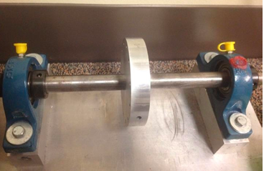
Introduction
A rotor-bearing testbed was built to analyze the health condition of the shaft with unbalance defects.

Slide 4
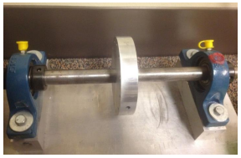
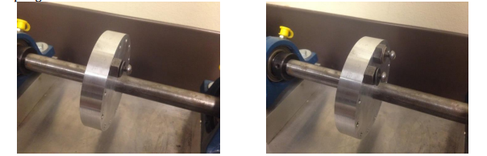
Problem Description
Rotating speed of test-bed: 20 Hz
Screws added on the disk of the shaft to induce unbalanced defects
Accelerometer mounted on the bearing block to measure vibrations
Vibration data collected under normal condition and unbalanced condition
Sampling rate: 2560 Hz
Balanced test bed
Unbalanced test bed with 1 (left) and 2 (right) screws

Slide 5
Methodology: Model Training
Model Training
Train an SOM model using the extracted features (at 1X and 2X harmonics, this is decided by conducting PCA for various features) from the healthy, faulty_1 & faulty_2 datasets.
The model learns the patterns associated with each condition, enabling it to differentiate between healthy and faulty states.
Model Testing and Classification
Test the trained model on the unlabeled dataset.
Classify each signal in the testing dataset as either healthy or faulty_1 or faulty_2 based on the learned patterns using confusion matrix.
Conclusion
The process leverages signal processing and machine learning to effectively assess the health condition and level of faulty behaviour by training with appropriate data sets.

Slide 6
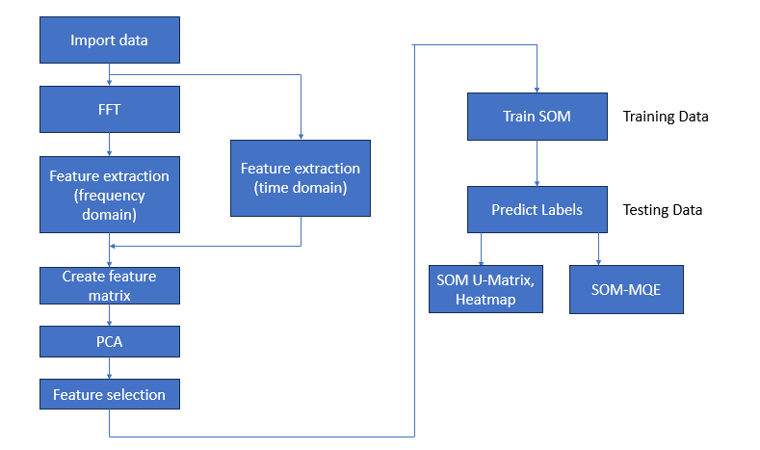
Workflow

Slide 7
Data Analysis
Data Loading
Load vibration data from three datasets: healthy, faulty, and testing.
Pre-processing
Apply filtering to remove noise and unwanted frequencies.
Normalize the data to ensure uniformity across all samples.
Feature Extraction
Utilize frequency domain analysis to identify key features that distinguish healthy conditions from faulty ones.
Focus on extracting features such as the amplitude of the 1X harmonic component, which is directly related to the shaft's rotating speed.

Slide 8
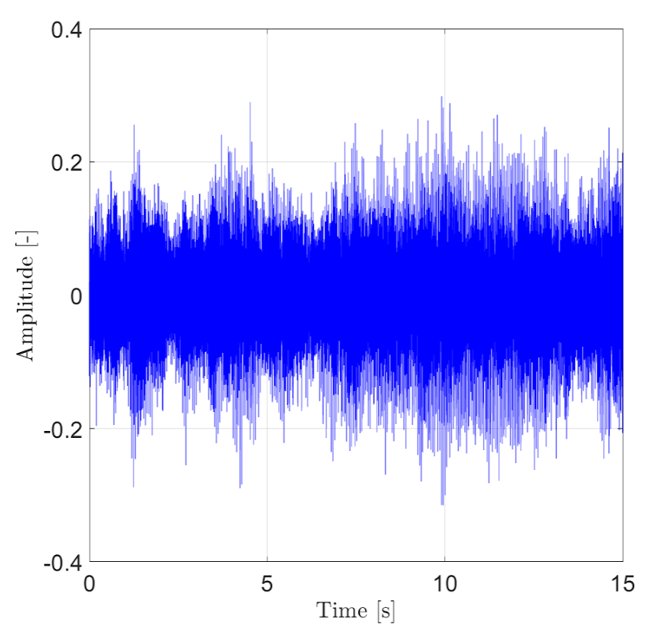
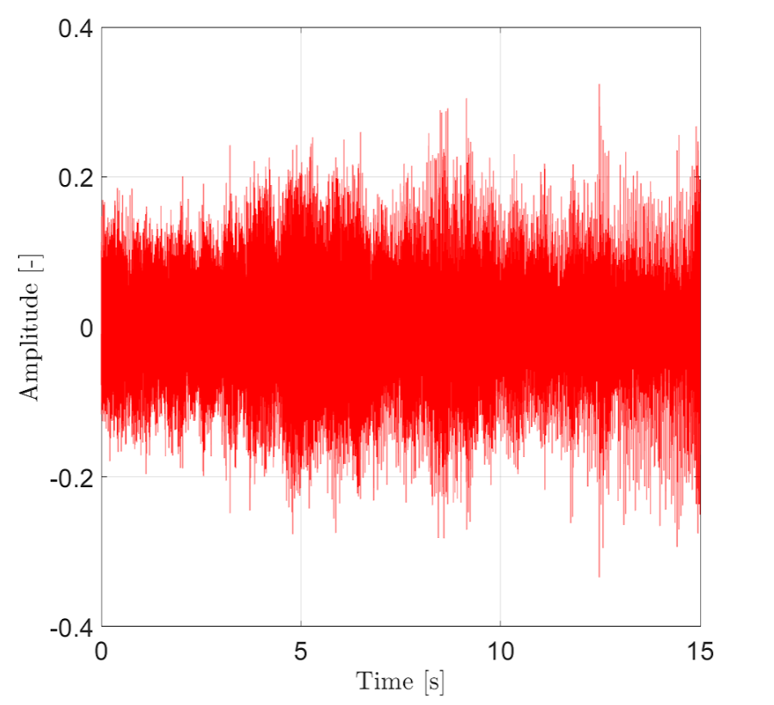
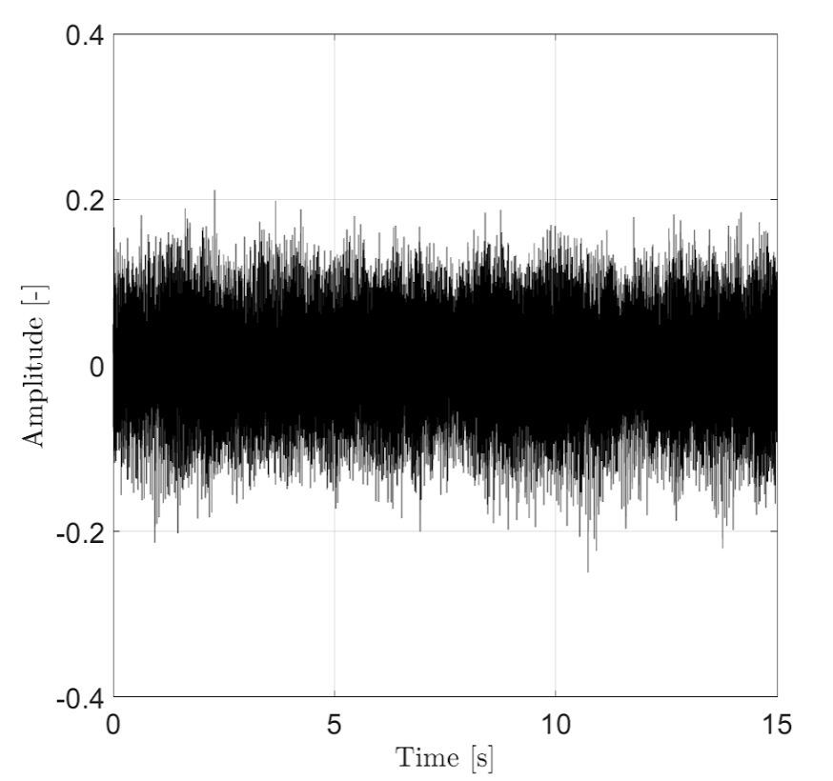
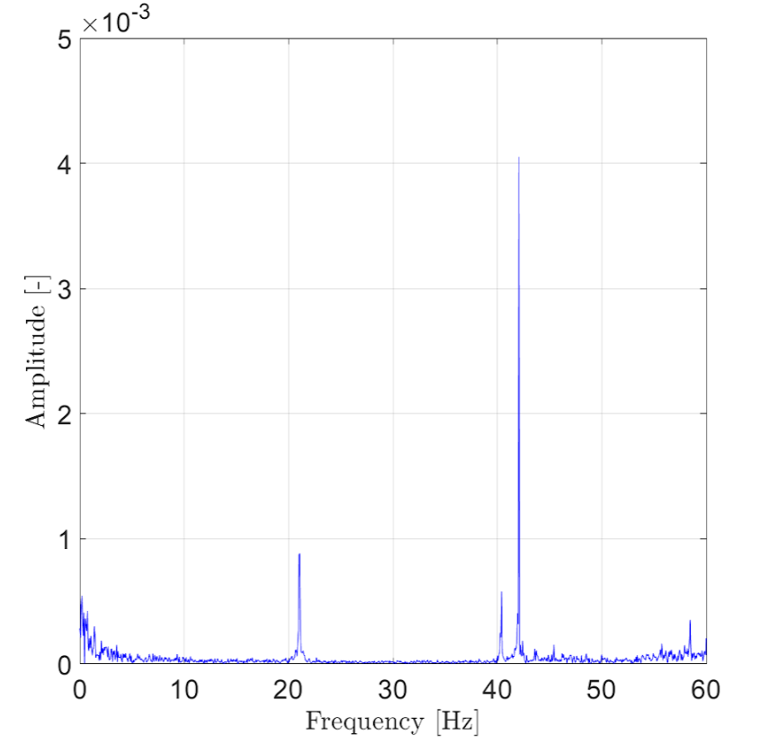
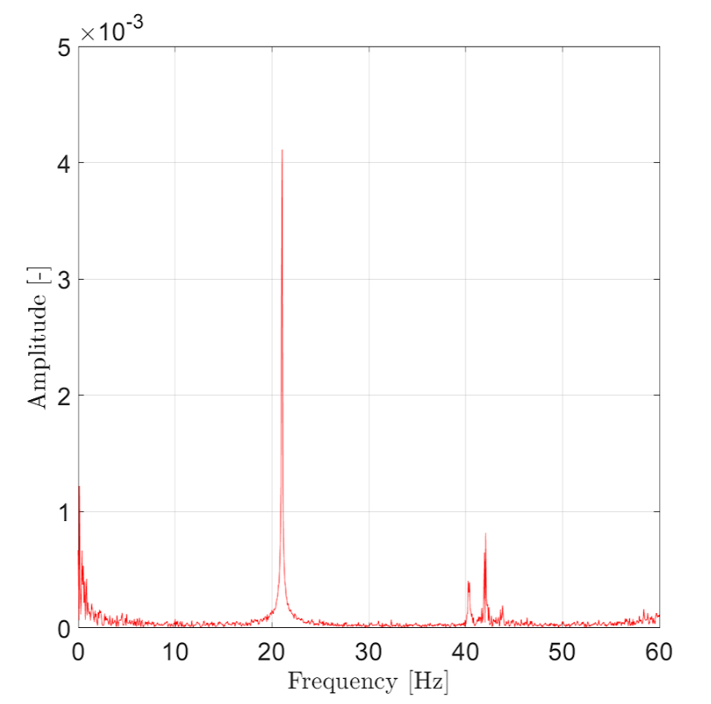
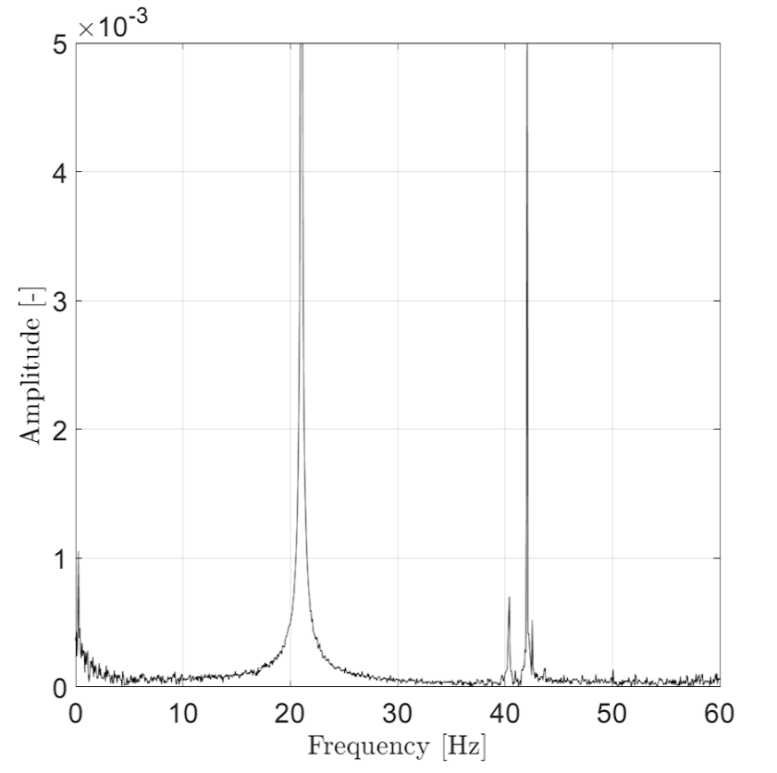
Data Analysis Cont’d
Time domain
Frequency domain
Healthy
Faulty unbalance 1
Faulty unbalance 2

Slide 9
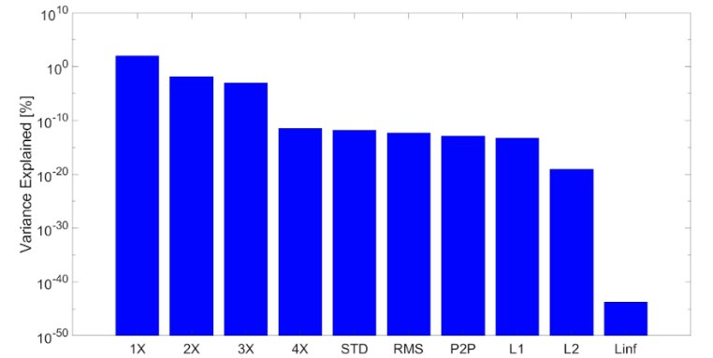
Principal Component Analysis
1X and 2X harmonic frequencies appear are the dominant features

Slide 10
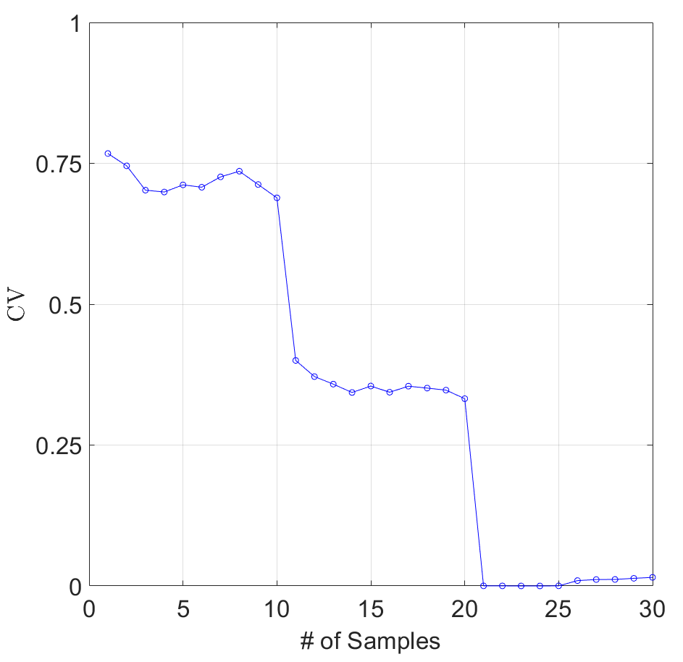
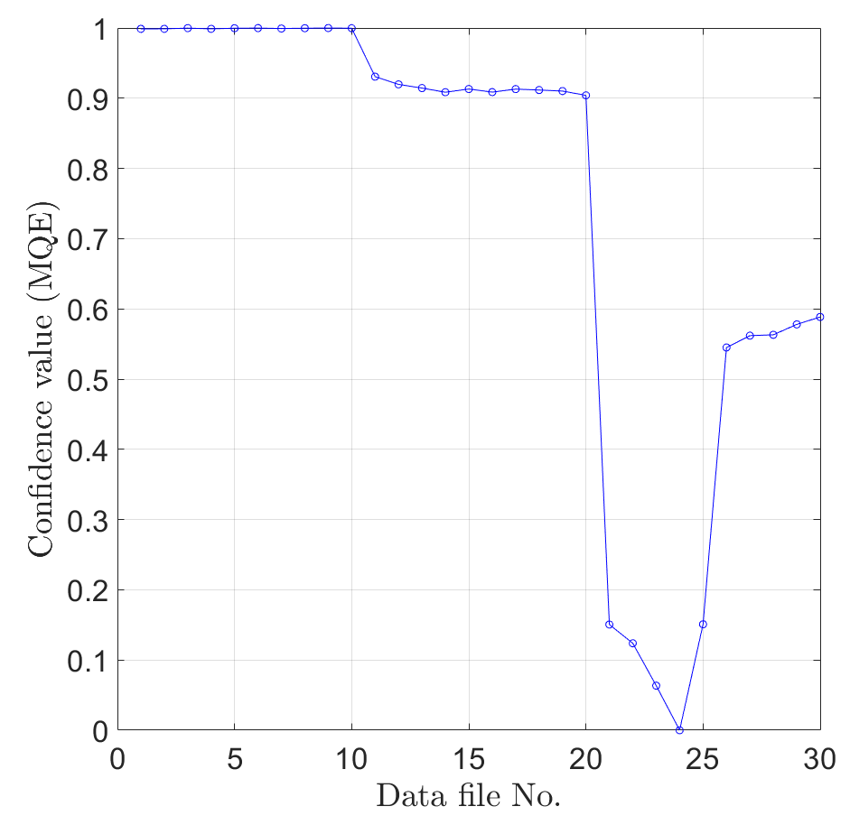
Results
Healthy
Healthy
Faulty-1
Faulty-1
Faulty-2
Faulty-2
Testing data results from LR (left) and SOM-MQE (right) using the 1X harmonic only

Slide 11
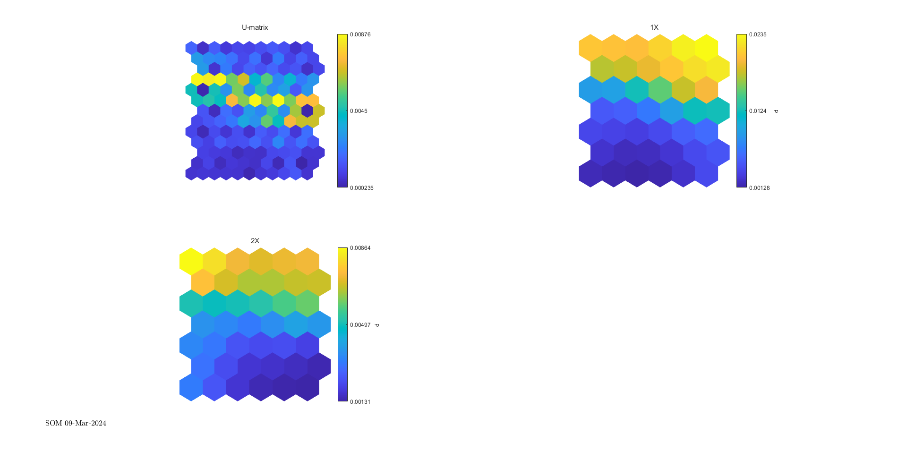
Results
SOM U-Matrix: Full (left), 1X harmonic (center), and 2X harmonic (right)

Slide 12
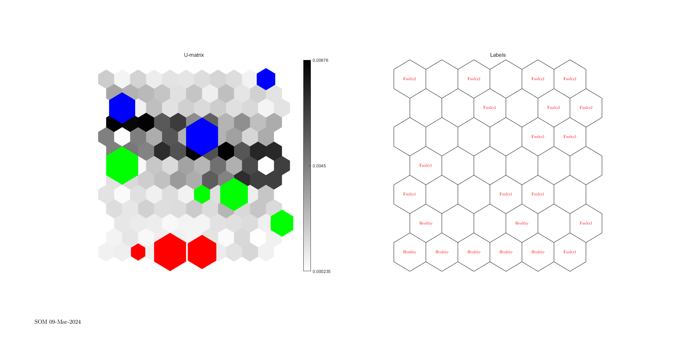
Results
SOM U-Matrix with Labels

Slide 13
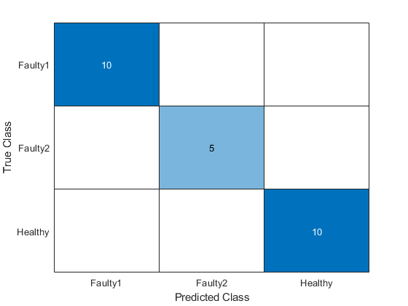
Confusion Matrix
SOM prediction
25/30 cases are correct
5/30 are unlabeled
Alternative features used:
2X only → 20/30 correct
1X, 2X, and 3X → 24/30 correct
No improvement from including other features
RMS, STD, Peak-to-peak

Slide 14
Conclusion
PCA identified the 1X and 2X harmonics as the most significant features for distinguishing health conditions, while RMS and standard deviation were less significant.
The SOM model accurately classified testing data into healthy, unbalance 1, and unbalance 2 conditions using extracted features.
Logistic regression effectively predicted the machinery's health state, distinguishing between healthy and faulty conditions, including different levels of unbalance.
Both SOM and logistic regression models showed promising performance in classifying the health state of the rotor-bearing system, offering valuable insights into fault diagnosis in rotating machinery.

